Slide 1
RFID-Based
2D Hand-Trajectory Tracking
on a Tag-Instrumented Desktop Surface
A time-aware, confidence-gated dual-branch deep-learning pipeline that reconstructs hand motion from 8 passive RFID tags observed by 2 antennas, using a camera-ArUco ground truth.
Warren Xu · Fiona Yu · April 2026

Slide 2
01 · MOTIVATION
Why track a hand with RFID?
Cameras, IMUs and specialized gloves dominate hand tracking — but every one of them demands line-of-sight, wearables, or power-hungry hardware.
Passive RFID tags are the opposite extreme: battery-free, ~$0.10 each, invisible under a surface, and readable through occlusion. If we can recover where the hand is from the RF signals alone, we unlock a low-cost, unobtrusive interaction layer for any flat surface — desks, tabletops, shelves.
The catch: the signal is brutal. Phase wraps every 2048 units, RSSI drifts with multipath, and a tag reply is irregular — we may get no fresh read for seconds. A naive model will happily collapse to the mean.
Irregular sampling
Reads arrive asynchronously; dt varies. Per-tag fill rate ranges from < 1% to ~99% across channels.
Phase is ambiguous
Raw phase is a sawtooth mod 2048. Small motions look like giant jumps without wrap handling.
Dead & ghost channels
Some tag/antenna pairs never report. Others echo stale data — training must know the difference.
RFID 2D Hand-Trajectory Tracking
2

Slide 3
02 · EXPERIMENTAL SETUP
8 tags, 2 antennas, one ArUco ground truth
Hardware layout
Top-down schematic
Top-down schematic
8 passive UHF RFID tags adhered to a desktop in a fixed grid pattern.
2 reader antennas (ant1, ant4) positioned above/alongside the surface; both query the same 8-tag population.
Per read: RSSI (dB) and phase (raw integer, 2048-period) at host timestamp.
Overhead camera + ArUco markers on the wrist stream WRIST_x / WRIST_y in table-plane coordinates — the regression target.
ant1
ant2
overhead camera → ArUco GT
overhead camera → ArUco GT
ant1
Dataset collected
2 sessions · 435 synchronized samples · ~125 s per session of free-form hand motion on the tabletop.
16 antenna–tag channel pairs total (2 × 8); 1 pair excluded upstream due to consistently malformed phase.
Mean RSSI-fill rate per channel ≈ 72% — confirming that missing reads are the rule, not the exception.
ant4
tabletop
tabletop
RFID tag (×8)
RFID tag (×8)
antenna
antenna
RFID 2D Hand-Trajectory Tracking
3

Slide 4
03 · DATA PREPARATION
From raw reads to 14-feature channel tensors
16
14
2048
antenna × tag channels fed to the model
features per channel per timestep
period of the raw phase integer
Raw & masked
Imputation
Time awareness
Dynamics
RSSI_z (z-scored per ch.)
sin(φ), cos(φ) on 2π·φ/2048
m_rssi, m_phase real-read mask
imp_rssi, imp_phase flags
forward-fill last valid read
exposes 'stale' vs 'fresh'
tslv time-since-last-valid
c = exp(−λ·tslv) confidence
channel death ⇒ attn mask
r_dot ΔRSSI / Δt
p_dot wrapped Δφ / Δt
unwrap_vel unwrapped φ-vel
Windows of T = 16 consecutive samples; only kept if WRIST(x,y) is valid on every step and at least one live channel is present.
RFID 2D Hand-Trajectory Tracking
4

Slide 5
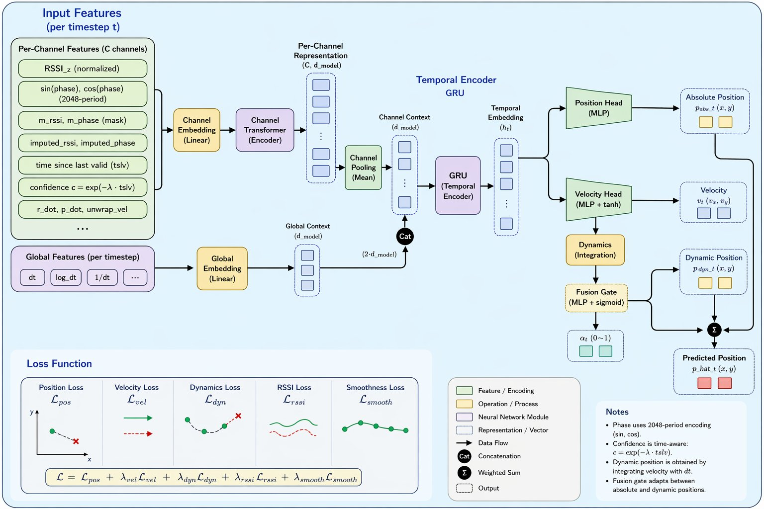
04 · MODEL
Time-aware, confidence-gated, dual-branch tracker
Channel Transformer
Lets the 16 antenna–tag channels attend to each other per timestep; dead channels are masked out of attention.
Temporal GRU
Fuses the pooled channel context with global dt features → hidden state hₜ carrying short-term motion memory.
Dual-branch fusion
α·p_abs + (1−α)·p_dyn. α is gated by confidence & real-read rate — low evidence ⇒ trust physics integration of v.
RFID 2D Hand-Trajectory Tracking
5

Slide 6
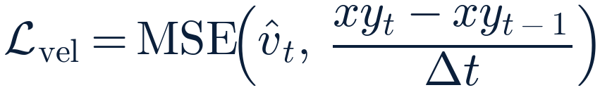

05 · TRAINING
Four losses: position, velocity, dynamics, smoothness
ℒ_pos
ℒ_vel
Combined objective
The anchor. Penalizes every predicted point against the ArUco target.
Forces the velocity head to match the numerical derivative of ground truth.
Position dominates; the other three act as physics and smoothness regularizers.
Training setup
ℒ_dyn
ℒ_smooth
optimizer | AdamW, lr = 1e-3, weight-decay = 1e-4
schedule | 60 epochs · batch 16 · grad-clip 2.0
window T | 16 samples (~1.6–3 s of hand motion)
split policy | temporal — 168 train / 42 val windows
channels used | 15 antenna-tag pairs (1 dropped upstream)
model | Tx d_model = 32, 4 heads · GRU 128
Couples the two branches: integrated velocity must match emitted position.
Damps high-frequency jitter in the velocity head.
RFID 2D Hand-Trajectory Tracking
6

Slide 7
06 · RESULTS — QUANTITATIVE
Temporal-split evaluation — the honest metrics
0.131
0.108
0.036
2.68 %
pos. RMSE L2
pos. MAE
vel. RMSE L2
hit-rate @ ε
(units = normalized tabletop)
mean L2 per point
vx, vy combined
ε = 0.02 (≈ tag spacing / 25)
Full temporal-split report
Why we report temporal-split
42 val windows · 672 points · window T = 16
split | val loss | verdict
merged_random | 0.00039 | leaks
temporal | 0.131 RMSE | honest
metric | x | y | L2 / combined
position RMSE | 0.1096 | 0.0721 | 0.1312
position MAE | 0.0804 | 0.0605 | 0.1081
velocity RMSE | 0.0279 | 0.0230 | 0.0361
per-window mean L2 (µ ± σ) | — | — | 0.108 ± 0.033
final-step L2 (µ ± σ) | — | — | 0.144 ± 0.092
Random-window splits place sample k in train and k+1 in val — and consecutive windows share 15 of 16 timesteps. Temporal split holds out a full tail trajectory and is the only fair measure of generalization.
Scale check — WRIST(x, y) lives in a normalized tabletop frame with usable range ≈ ±0.25 along x and ±0.15 along y. An L2 of 0.131 is therefore ~26 % of the half-width — the model recovers rough location, not precise tracking. The 2.68 % hit-rate at ε = 0.02 shows fine-grained localization has not emerged yet.
RFID 2D Hand-Trajectory Tracking
7

Slide 8
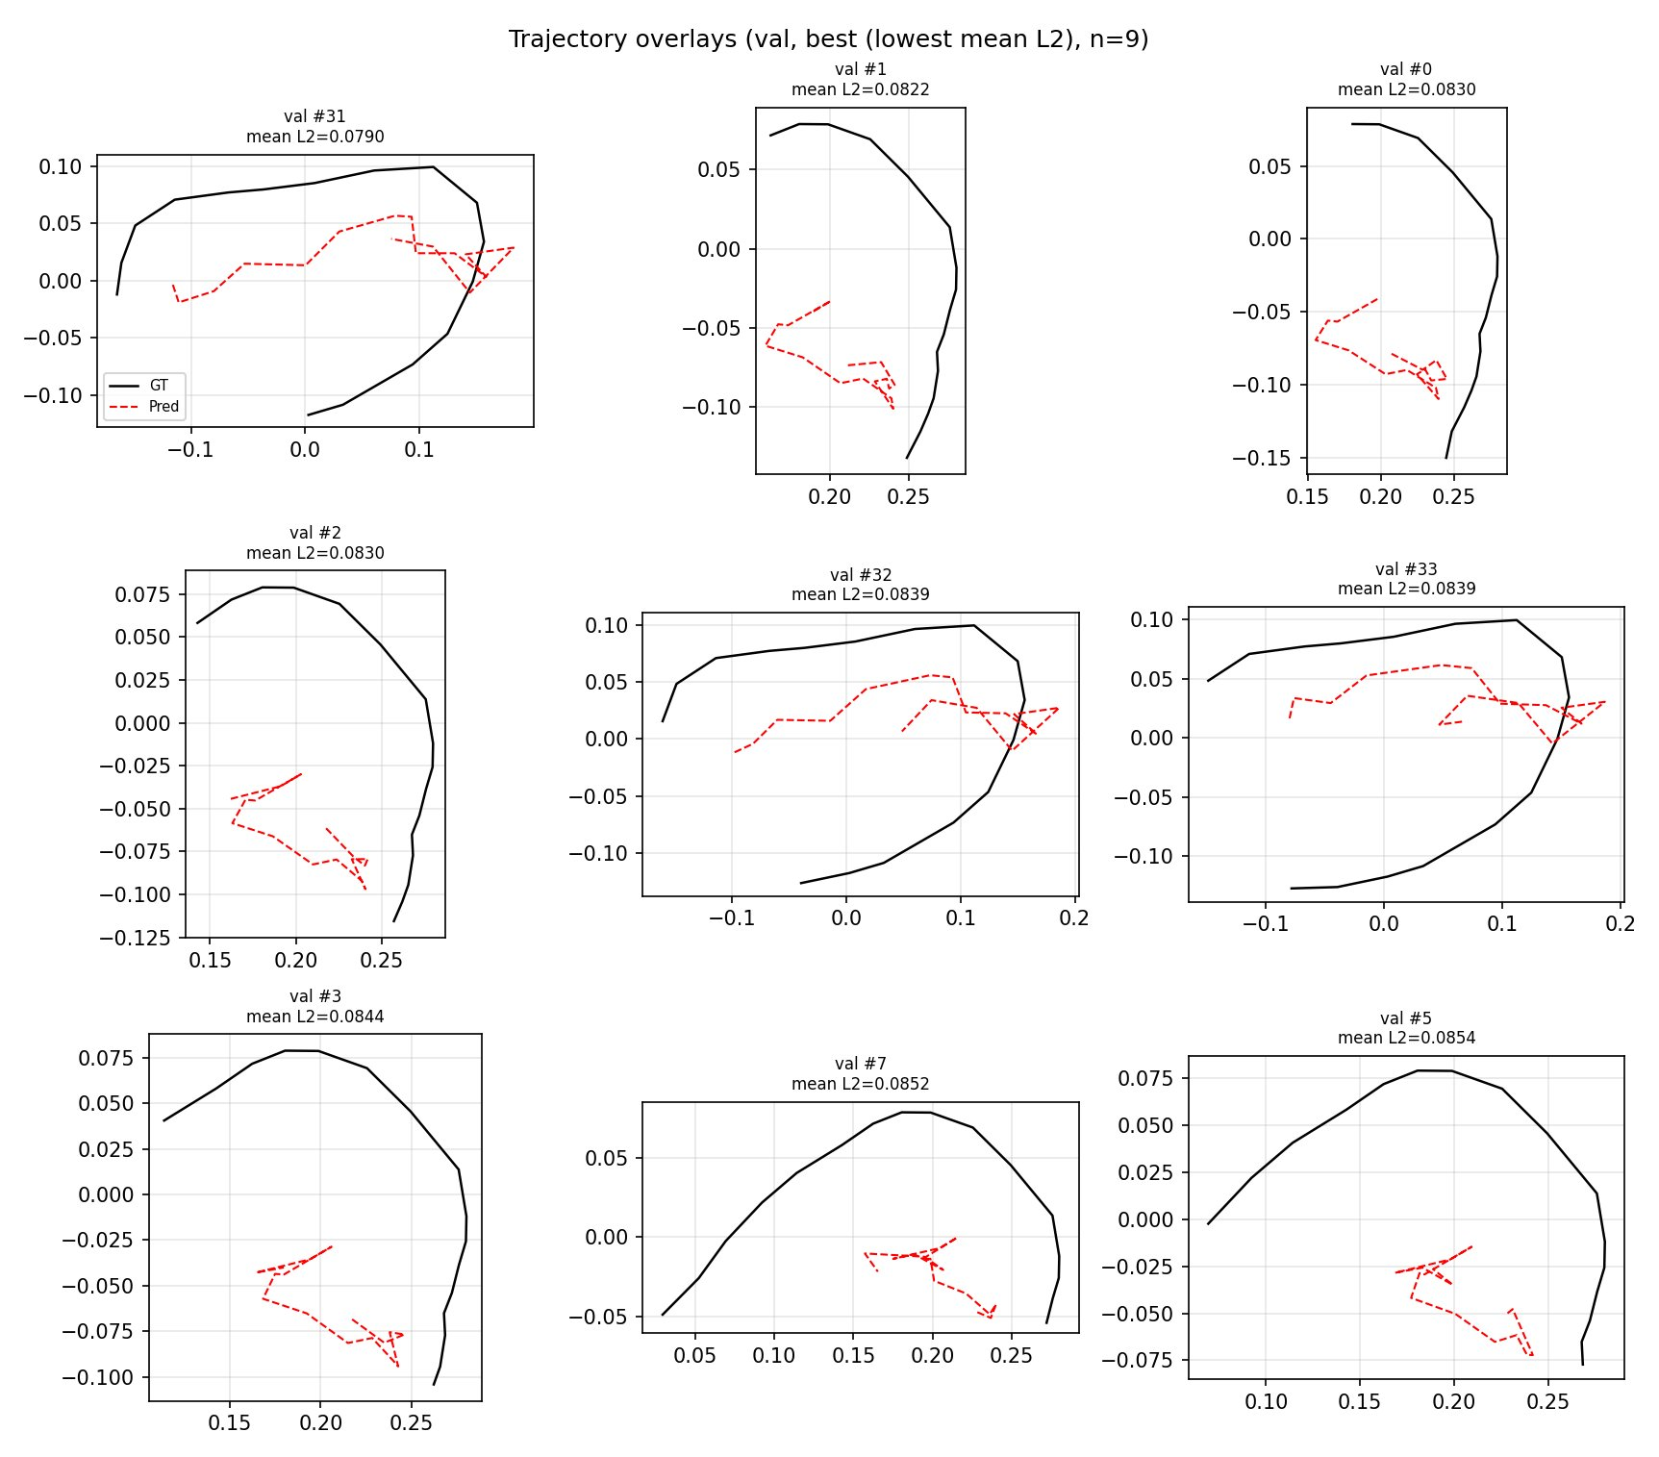
07 · RESULTS — QUALITATIVE
GT vs predicted trajectory — best 9 val windows
What to see
All panels show temporal-split validation — the hard test.
Black — ArUco ground truth.
Red dashed — model prediction.
Prediction clusters near the workspace centroid; GT traces much larger loops (RMSE 0.131).
Motion shape is partially recovered (see val #31) but amplitude is heavily shrunk.
A classic regress-to-the-mean signature driven by a tiny dataset (435 samples, 42 val windows).
RFID 2D Hand-Trajectory Tracking
8

Slide 9
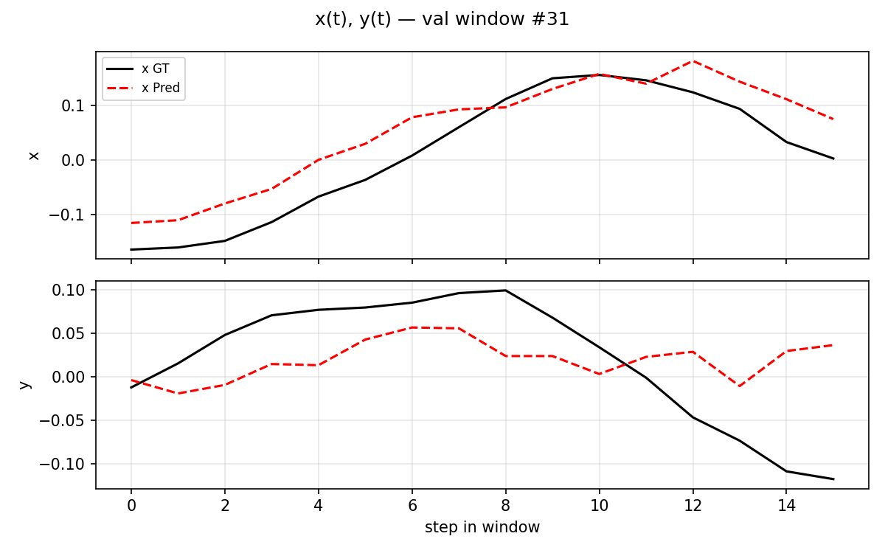
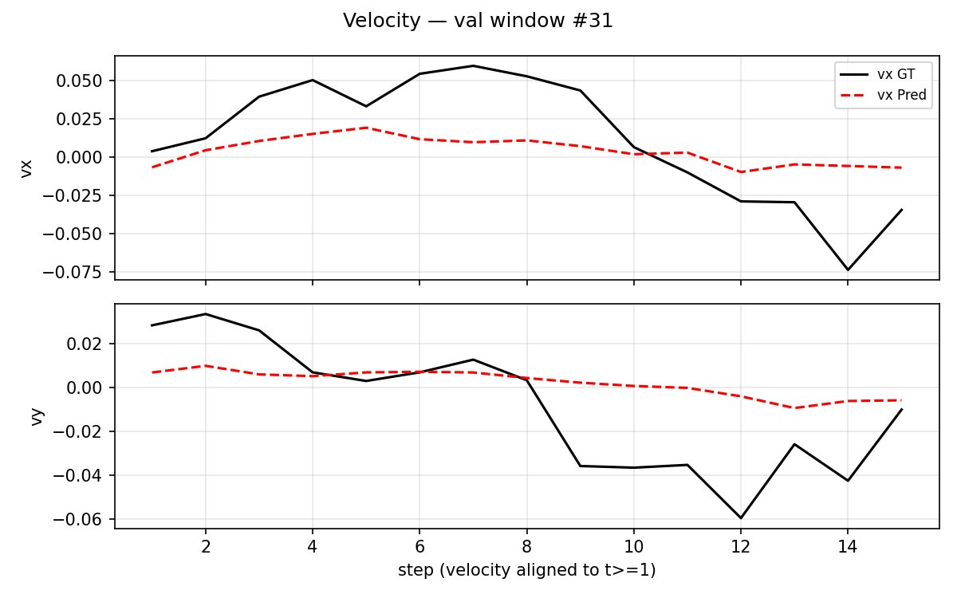
08 · RESULTS — PER-STEP DRILL-DOWN
x(t), y(t) and velocity on val window #31
Position tracks the trend but flattens
Velocity head under-estimates magnitude
x follows the rising-then-falling GT, y loses the second descent. The prediction is biased toward the workspace centroid.
Predicted vₓ, v_y oscillate tightly around 0 while GT reaches ±0.07. The tanh·vel_scale = 0.08 bound is not the cause — the model simply has not learned the mapping.
RFID 2D Hand-Trajectory Tracking
9

Slide 10
09 · DIAGNOSIS
What is limiting the model right now?
1. Dataset is tiny
2. Calibration gap
Two sessions, ~435 samples, ≈84 valid windows after split — far below what a transformer + GRU with ~100k params needs to generalize. The model memorizes the mean hand location.
Phase per tag/antenna pair has an unknown integer offset. The 2048-period wrap is modeled, but per-channel bias is left for the network to discover from 435 points.
3. Velocity signal is weak
4. Split-policy amplifies the issue
Because position loss dominates early training, ℒ_vel gradient is crowded out. vel-head stays near the init and the dynamics branch becomes a trivial 'carry-over' of the previous position.
With only ~210 windows, every partition is fragile. A random split gives an artificially rosy 0.00039 val loss by leaking adjacent frames; temporal split exposes the true 0.131 RMSE. Either way, 42 val windows is too few to steer the model.
RFID 2D Hand-Trajectory Tracking
10

Slide 11
10 · FUTURE WORK
Three paths to push L2 below 0.03
01
02
03
Collect 10× more data
Per-channel phase calibration
Physics-anchored decoder
Run 20+ sessions across different users and hand speeds. 435 samples is a prototype — real training needs thousands.
Measure the static phase offset per tag/antenna pair with the hand removed, subtract it before feeding the network, and let the model learn only motion-induced phase.
Replace the free MLP position head with a triangulation-style layer that reads tag positions and constrains p̂ to lie on the surface — narrows the solution space.
Additional levers: multi-loss rebalancing (schedule ℒ_vel ↑ after ℒ_pos plateaus); data augmentation on the phase channel; knowledge distillation from an EKF/particle-filter baseline.
RFID 2D Hand-Trajectory Tracking
11

Slide 12
Takeaways
A dual-branch tracker is the right scaffold.
The bottleneck is data, not architecture.
Built end-to-end
Shape, not amplitude
Next step is data
From raw CSV through 14-feature channels to a 2-branch model trained with 4 losses.
The model captures the curvature of hand motion but shrinks toward the workspace center.
10× data + per-channel phase calibration should cut mean-L2 by 2-3× with no model changes.
Thank you · Questions?

